Slide 1
Jira Every Day

Slide 2
Filters & JQL
Filters Customizing
Dashboards creation
Logwork
Advance search (JQL)
Google Sheet integration
Additional questions???

Slide 3
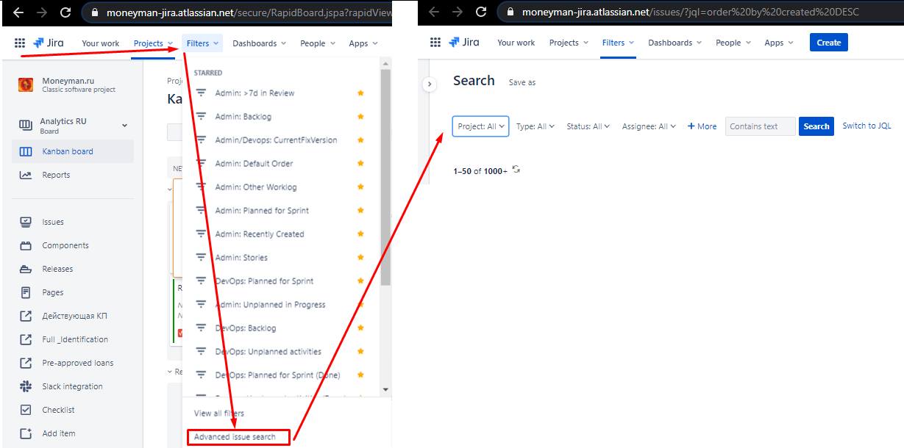
Filters export / sharing
Filters can be in:
Basic view (opened by default)
Advanced view (user should switch to advanced manually)

Slide 4
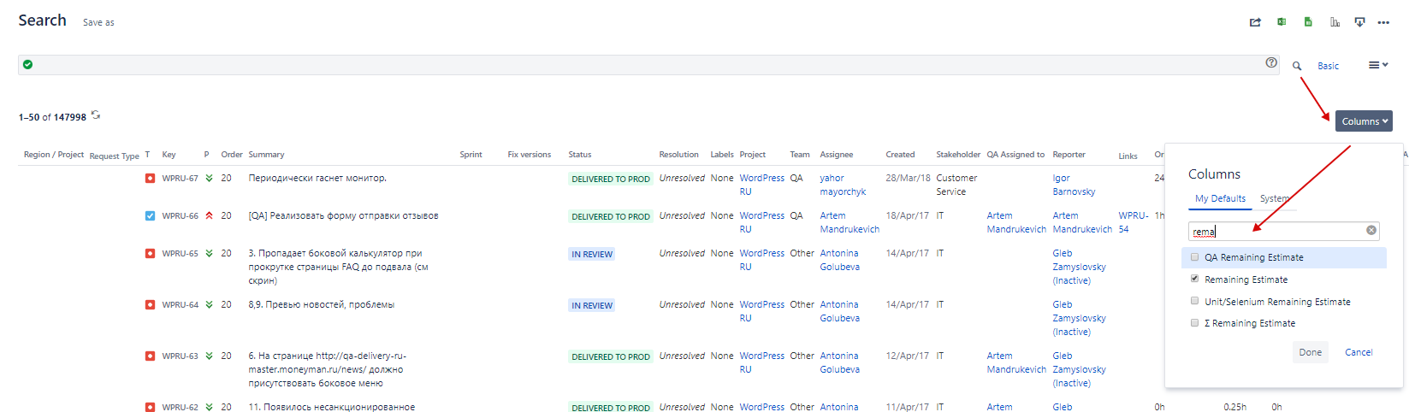
Filters export / sharing
For any type of filtering there is an opportunity to select any necessary columns as a result

Slide 5
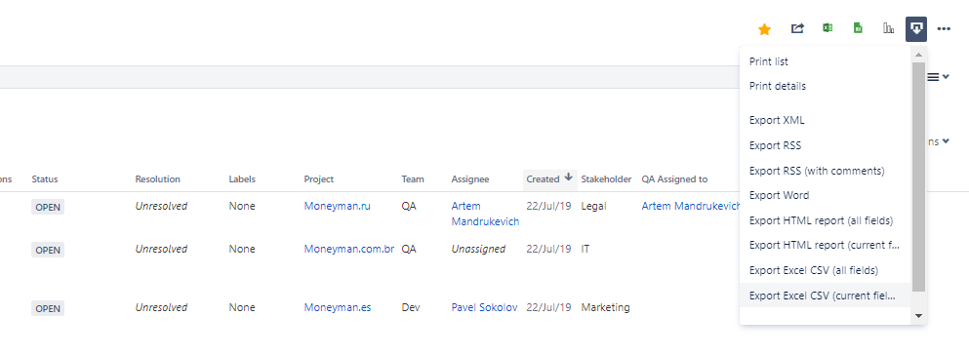
Filters export / sharing
All the results can be exported into the Excel file
All the columns (that are default for the user)
Only those, that are selected right now on the view
NOTE: once any filter is saved, set of saved columns becomes default for the user!!!

Slide 6
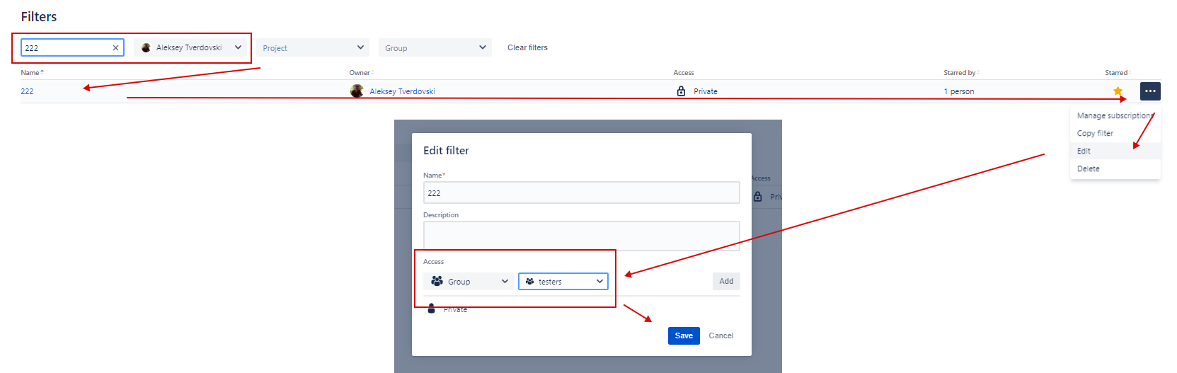
Filters export / sharing
To share the filter, the following steps should be done:
Run any filter
Save it (by clicking Save As button + selecting the name)
Find your filter (Menu -> Issues and Filters -> View all filters -> Edit)
Open settings for the filter and share it to the group

Slide 7
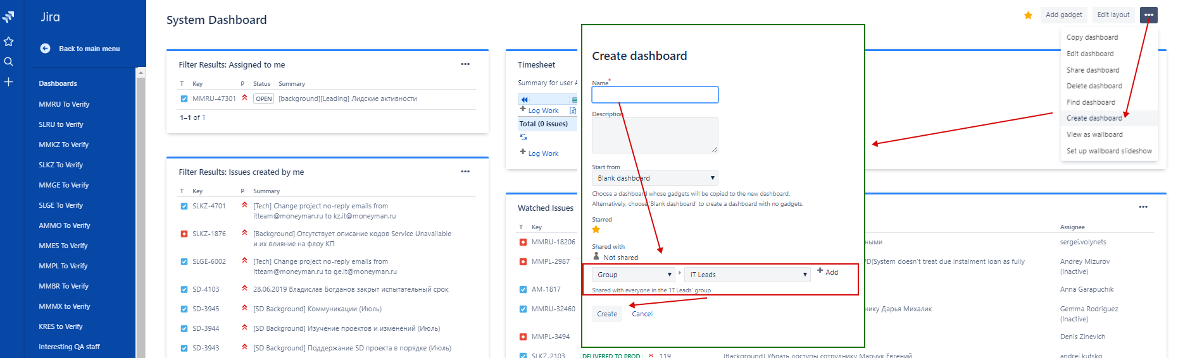
Dashboards
Seps to creat own dashboards:
Menu -> Dashboards (system board will be opened)
Go to the menu ... to open additional options -> select Create
Input name/data and share (if necessary)

Slide 8
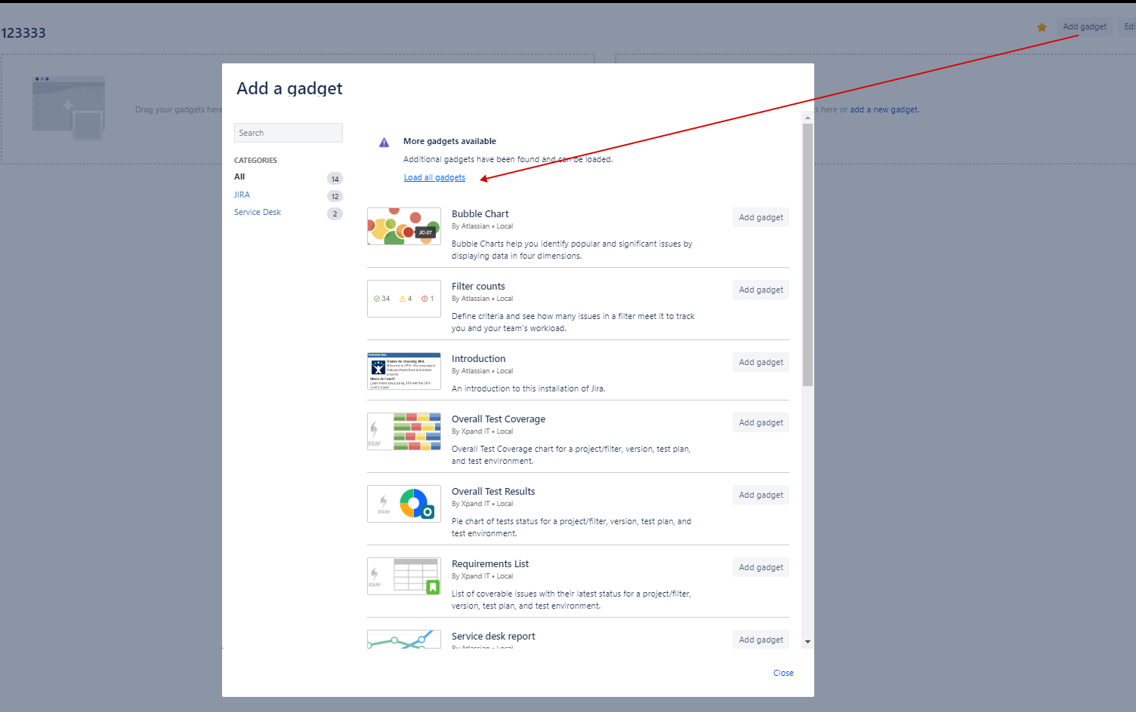
Dashboards / Gadgets
Click on Add Gadget
Click on Load all gadgets link and find any necessary gadget
Customize the gadget (add saved filter / necessary columns)
NOTE: to share board with filters, filters should be shared as well!

Slide 9
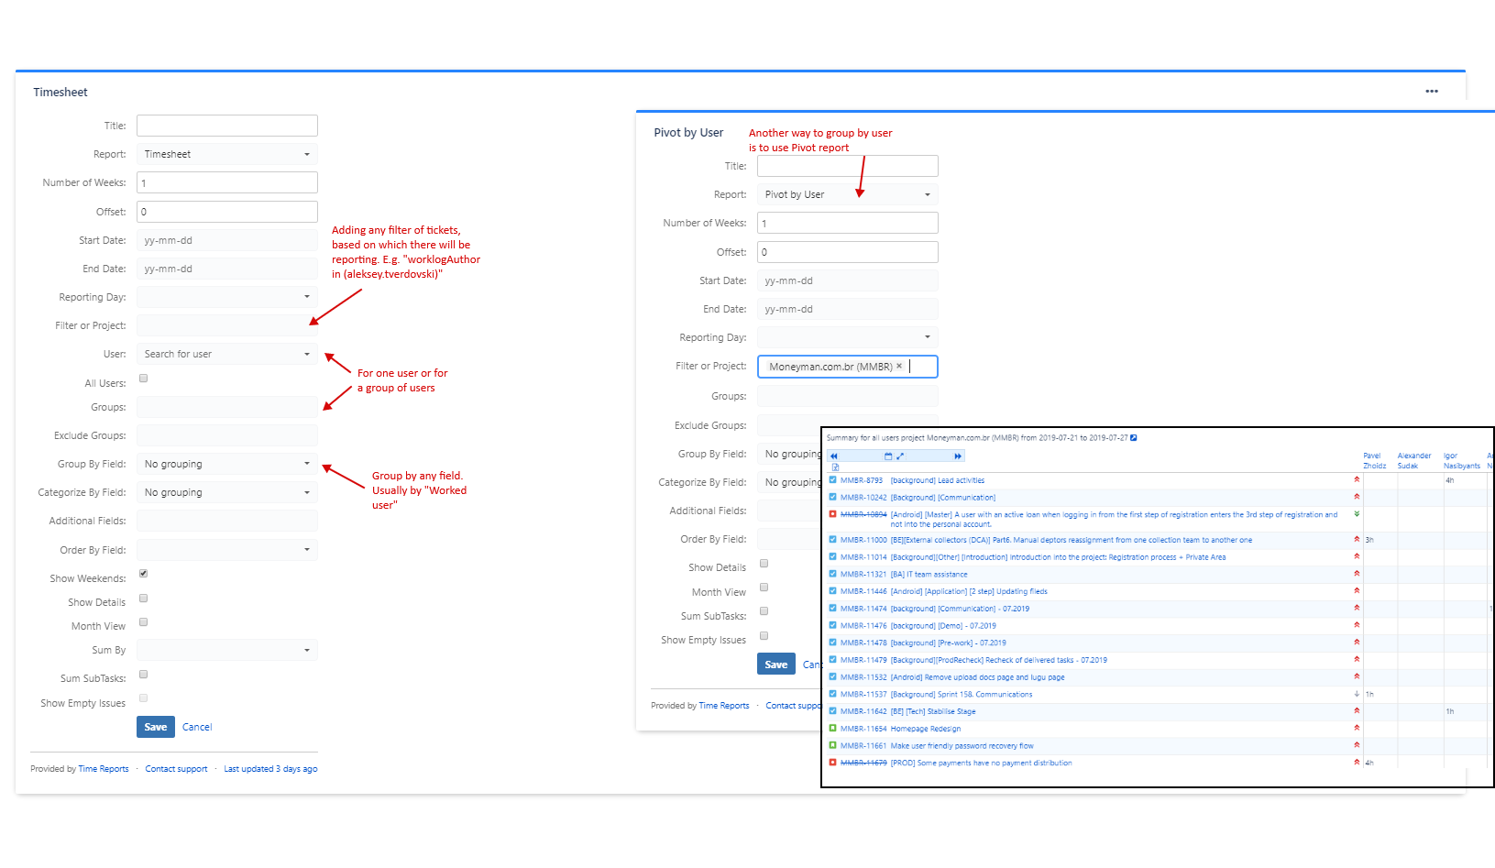
Time Reports
Open Dashboard and add Time Reports gadget
Select necessary filter/project and type of report/grouping

Slide 10
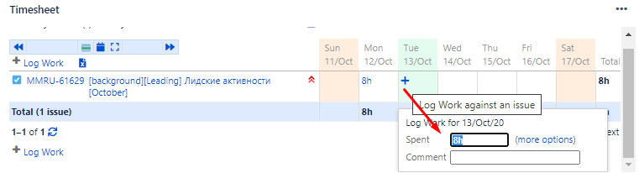
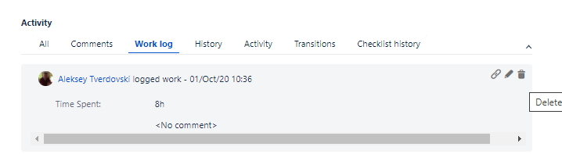
Logwork
Logwork can be done on Timesheet or on ticket screen
To delete worklog: open ticket -> open worklog tab -> delete/edit button for work log

Slide 11
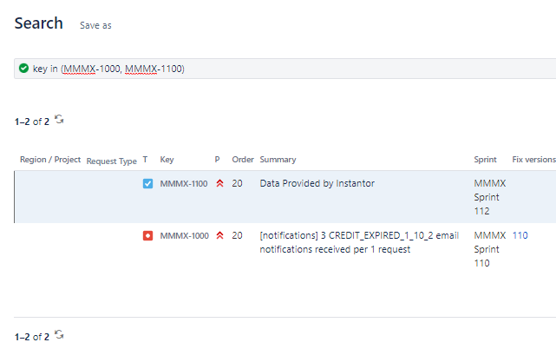
Advanced JQL
List of pre-defined tickets:
Key in (MMMX-####, MMMX-####, … )

Slide 12
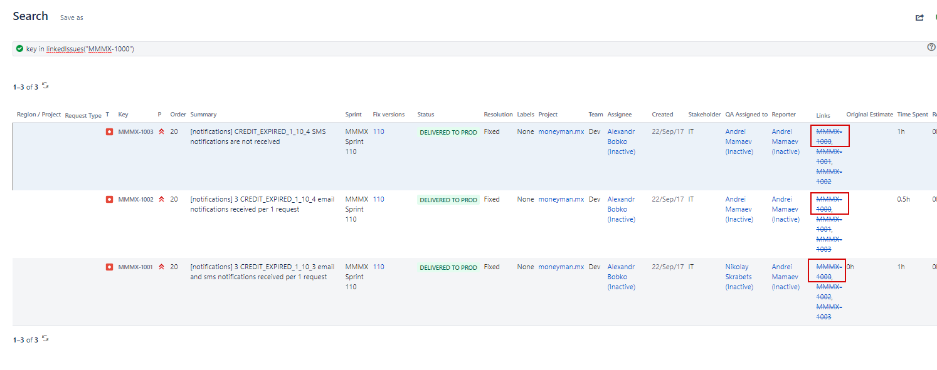
Advanced JQL
All issues, linked to the ticket:
key in linkedIssues("MMMX-####")

Slide 13
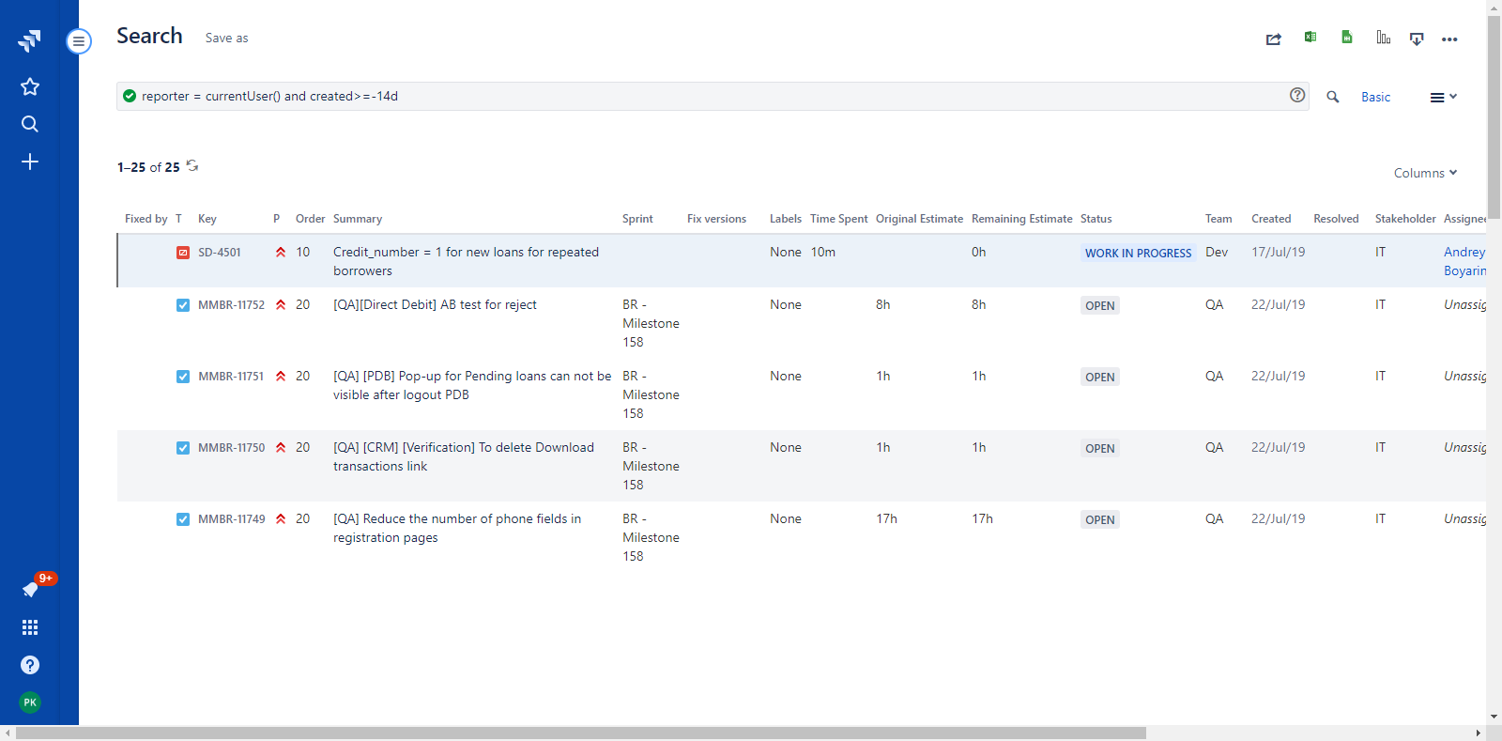
Advanced JQL
All issues, reported by current user during last 3 days:
reporter = currentUser() and created>=-14d

Slide 14
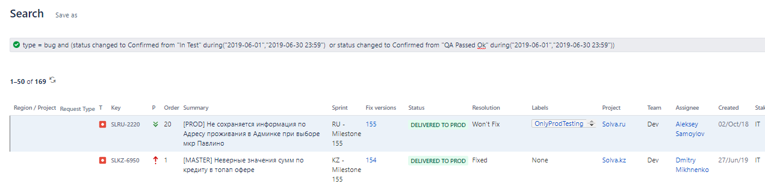
Advanced JQL
Bugs, that where reopened during testing in the previous month:
type = bug and
(status changed to Confirmed from "In Test" during("2019-06-01","2019-06-30 23:59") or status changed to Confirmed from "QA Passed Ok" during("2019-06-01","2019-06-30 23:59"))

Slide 15
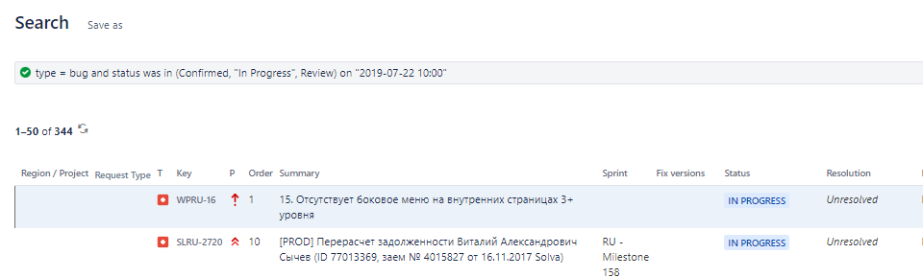
Advanced JQL
Bug was in specific statuses on the definite time
type = bug and status was in (Confirmed, "In Progress", Review) on "2019-07-22 10:00"

Slide 16
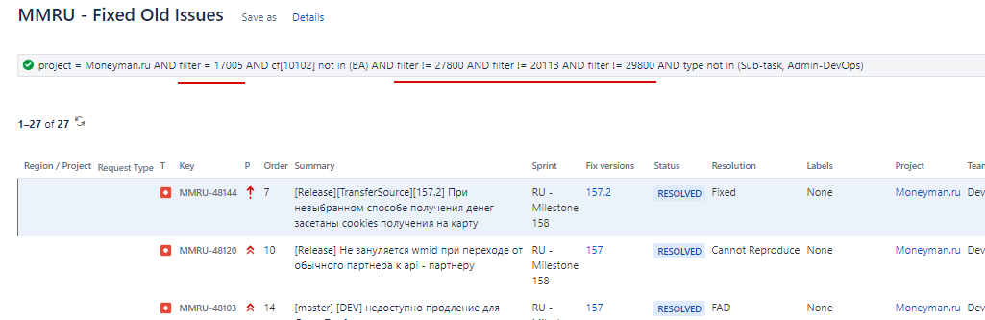
Advanced JQL
To make filter in filter:
Create and save one filter (or, for instance, get it from your lead)
Make new filter with additional extra condition
Filter = ##### and <new condition, e.g. assignee = currentUser()>

Slide 17
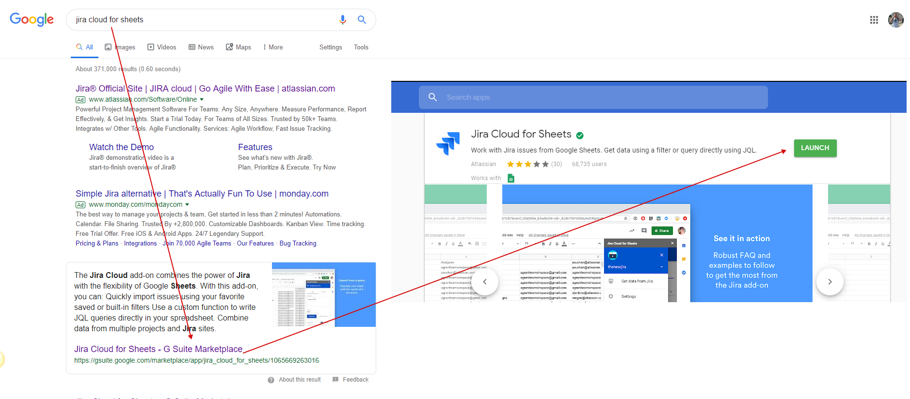
Googe Sheet Integration
To make new google sheet integration need:
Install addon for google sheet

Slide 18
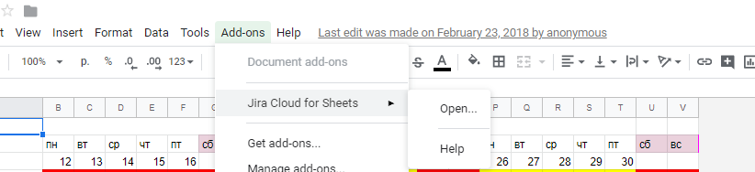
Googe Sheet Integration
2) Open add-on and give permissions

Slide 19
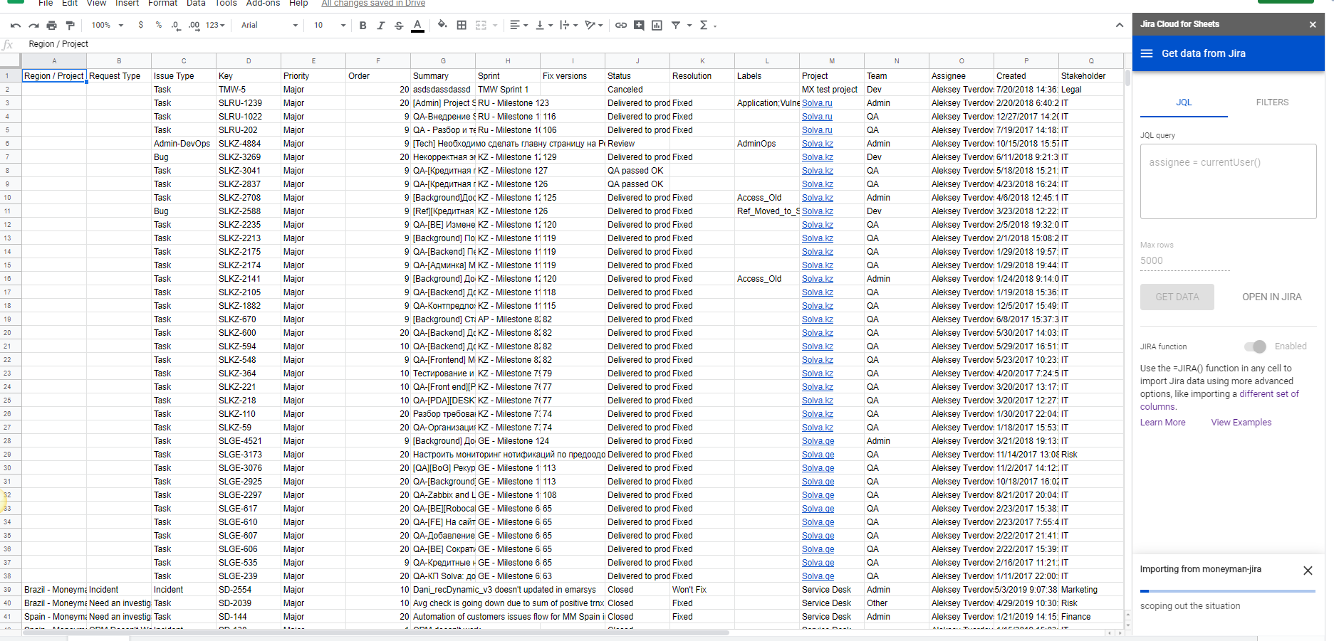
Googe Sheet Integration
There are two ways to load data:
Through the given menu
Using jira formula (e.g. =Jira(“assignee = currentUser()”,”key,summary”))

Slide 20

Additional Questions

